Slide 1
Lecture 3
The Boot Process

Slide 2

Learning Objectives
Understand the boot sequence
First baby step to being “DevOps”

Slide 3
The Agents in the (Linux) Booting Process
fetches
jumps
to
loads and
executes
Reset
Reset Vector
BIOS
Master Boot Record
executes
Init
/sbin/init
executes
executes
GRUB
(Grand Unified Bootloader)
Kernel
executes
Runlevel
/etc/rc.d/rc*.d

Slide 4
What happens with the x86 processor boot?
Power sequencing: hardware ensures various power sources are stable at their required voltages
A variety of hardware subsystems starts self-checks and initialization
Processor core’s PC will be set to the reset vector

Slide 5
Reset vector
The default value of the PC immediately after reset
After critical power and hardware checks
Hence it is the first instruction fetched
The chipset (the chips supporting the processor) must map this into the BIOS
First instruction is a long jump into the real entry of the BIOS code

Slide 6
Reset vector
8086 - physical address 0xFFFF0 (16 bytes below 1 MB). CS = 0xFFFF, IP = 0x0000
80286 - physical address 0x000FFFF0 (16 bytes below 1 MB). CS = 0xF000, IP = 0xFFF0
80386 and later x86 processors – 0xFFFFFFF0 (16 bytes below 4 GB). CS selector =0xF000, CS base = 0xFFFF0000, IP = 0xFFF0h

Slide 7
What about multiprocessor systems?
During the early reset stage, and at the end of the processors internal self-check, a hardware protocol is used to determine the bootstrap processor (BSP)
The protocol differs from processor generation and implementation but basically involve a competition for some kind of semaphore
One and only one of the cores will be the bootstrap processor
Only the BSP executes the boot sequence

Slide 8
BIOS
“Basic Input/Output System”
A firmware for hardware initialization and booting that resides in non-volatile memory
Updating by “flashing” the EEPROM
As of 2014, new PCs are shipped with its successor Universal Extensible Firmware Interface (UEFI)

Slide 9
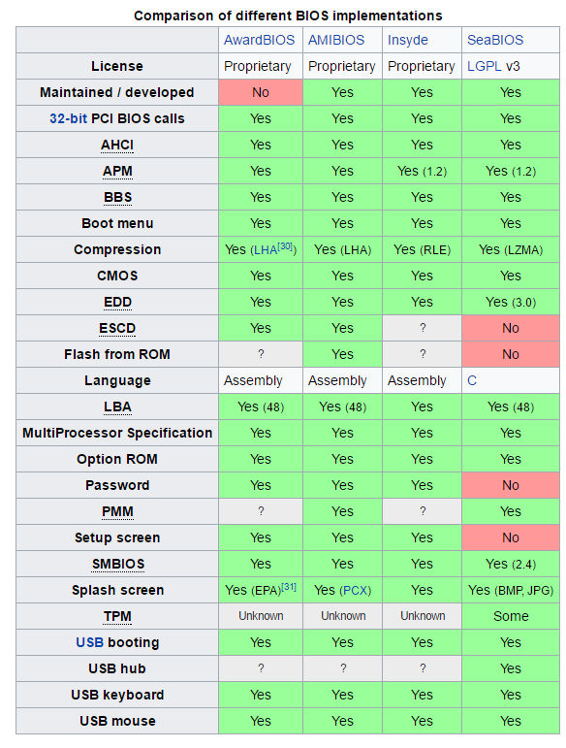
BIOS Implementations
Source: Wikipedia

Slide 10
Power-on Self-test (POST)
Executed very early in the BIOS code
Typical steps:
verify CPU registers
verify the integrity of the BIOS code itself
verify some basic components like DMA, timer, interrupt controller
find, size, and verify system main memory
initialize BIOS
pass control to other specialized extension BIOSes (if installed)
identify, organize, and select which devices are available for booting, organize, and select which devices are available for booting

Slide 11
Real mode
In real mode, memory is limited to 1MB
Upon power up, top 12 address lines asserted high, forcing address to 0xFFFxxxxx
If no mode transition after first long jump, enters real mode
Memory limited to 1MB

Slide 12
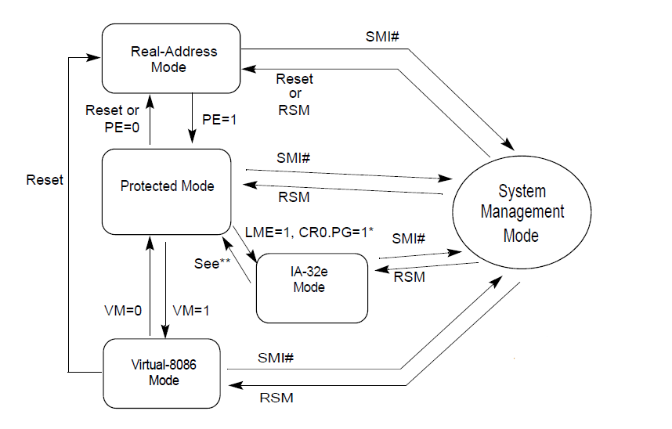
X86 mode changes

Slide 13
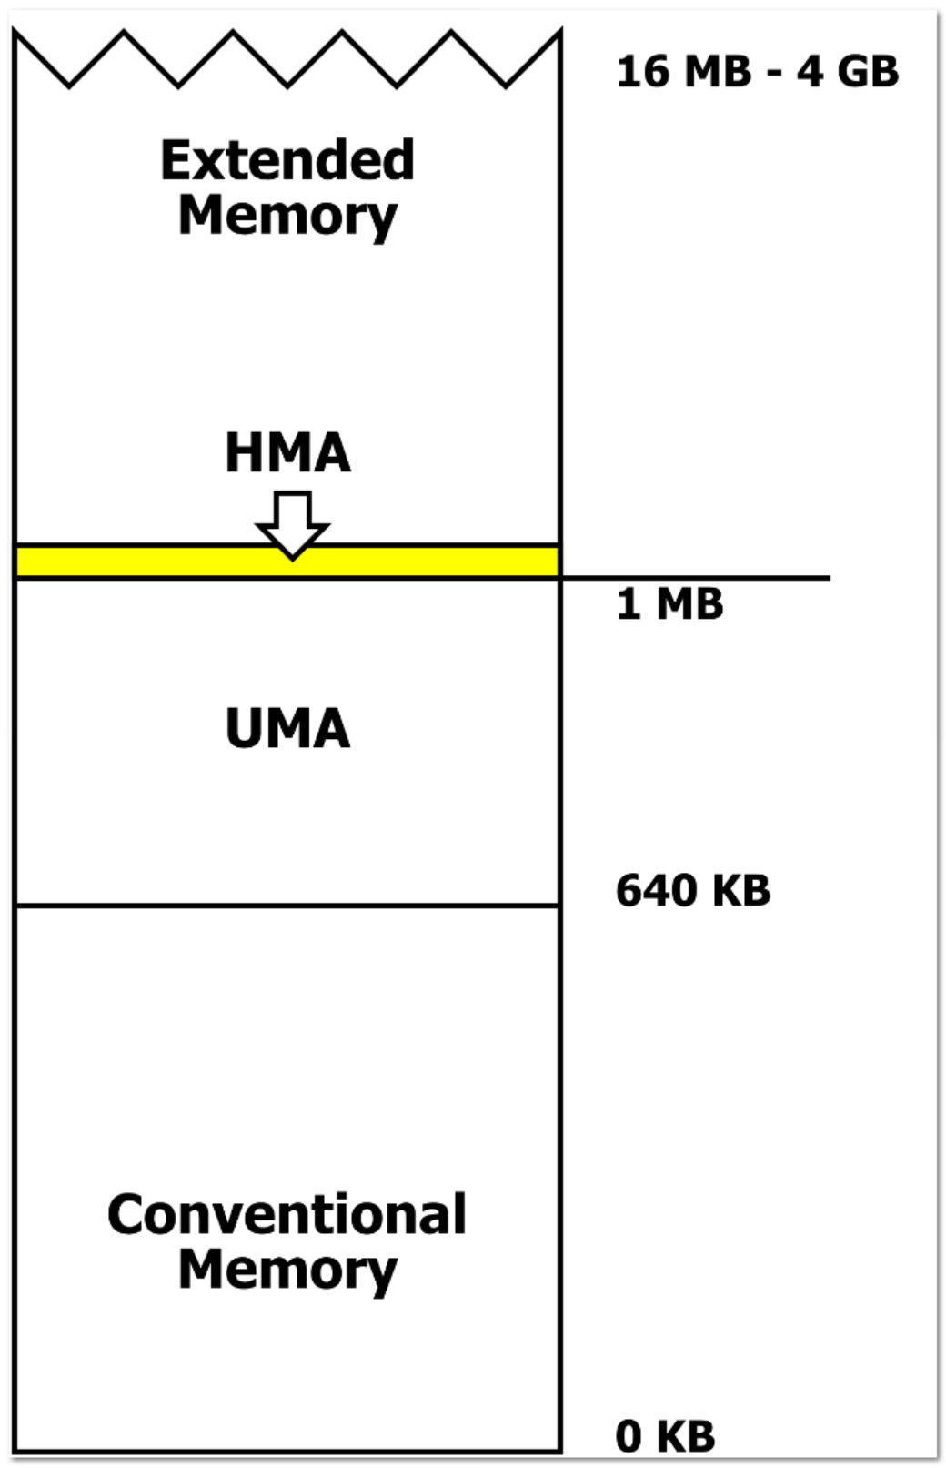
DOS memory management (Real mode)
Upper memory area (UMA) refers to the address space between 640 KB and 1024 KB (0xA0000–0xFFFFF).
Three 128 KB regions were defined in this area.
The 128 KB region between 0xA0000 and 0xBFFFF was reserved for video adapter screen memory.
The 32 KiB region between 0xC0000 and 0xC7FFF was reserved for video adapter Video BIOS memory.
The 160 KiB region between 0xC8000 and 0xEFFFF was reserved for device Option ROMs, and special RAM usually shared with physical devices
- Wikipedia

Slide 14

Digression – a pain from the past: A20
The original 8086 supports 1MB of memory.
But with real-address mode segmentation, one can have a segment register with value 0xFFFF and an offset of 0xFFFF
Written as ‘FFFF:FFFF’
FFFF:FFFF gives an effective address of 0x10FFEF (which is 21 bits!)
On 8086, it is ‘wrapped around’ to yield the address 0x0FFEF
80286 onwards gives an additional A20 (the 21st) address line
AND THE OPTION TO TURN IT ON OR OFF
VIA PROGRAMMING THE KEYBOARD!
https://wiki.osdev.org/A20_Line

Slide 15
The “Unreal” Mode
A small digression

Slide 16
“Unreal” Mode
Real mode 1MB memory constraint is too restrictive
A clever exploit of the Intel ISA allows for real mode addressing to go beyond 1MB
The main hurdle is the limit of using only 20 bit addresses
To get into “unreal” mode, need to do a real mode to protected mode switch and then back to real mode

Slide 17
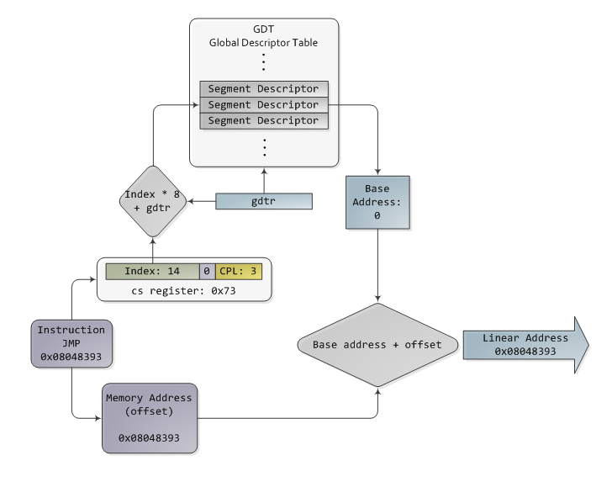
Segment Descriptor Cache Register
Used to speed up protected mode segment addressing
then no change in these either
Protected mode addressing
Cache it!
If no change

Slide 18
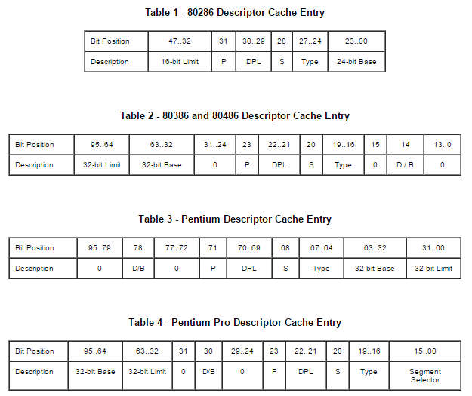
Segment Descriptor Cache
Format varies but…
after 80386 all segment limits
are 32 bits

Slide 19
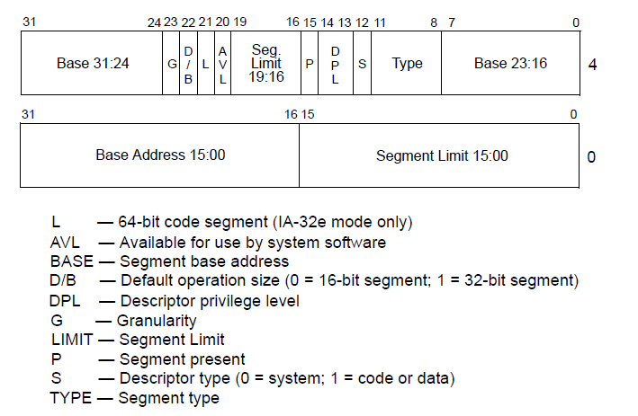
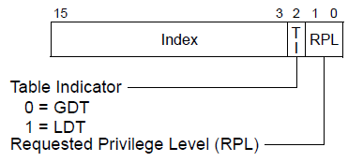
Using “Unreal” Mode - 1
Start in real mode. Do a switch to protected mode.
Set up the descriptors, selectors and GDT. Most important, set limit to 4GB. Make sure privilege level set appropriately.
Segment Selector
Segment Descriptor

Slide 20
Using “Unreal” Mode - 2
Switch back to real mode. Cache limit remains and takes precedence.
Use the “operand size prefix” (0x66) in instructions to enable the use of longer than 16 bit offset registers.
In (normal) real mode, address = seg * 16 + offset. If total sum exceeds 1MB, instruction fault.
In “unreal” mode, offset can now be full 32 bits (using the operand size prefix for some instructions) so while still address = seg * 16 + offset, since offset can be 32 bits, address can be 32 bits.

Slide 21
“Unreal” mode - caveat
Real mode interrupt assumes 16 bits IP. Code segment above 64KB needs special attention.
Unreal mode can be used by boot routines or for writing/supporting backward compatible applications
E.g. DOSBox
Requires special compiler support to generate the prefix

Slide 22
Back to our boot story…

Slide 23
BIOS software setup
At least must load an Interrupt Descriptor Table (IDT), a Global Descriptor Table (GDT), a Task-State Segment (TSS), and, optionally, a Local Descriptor Table (LDT).
Must also initialize some critical control registers and the memory type range registers (MTRR)
Once these set up, ready to boot the OS.
Note: still in real mode!

Slide 24
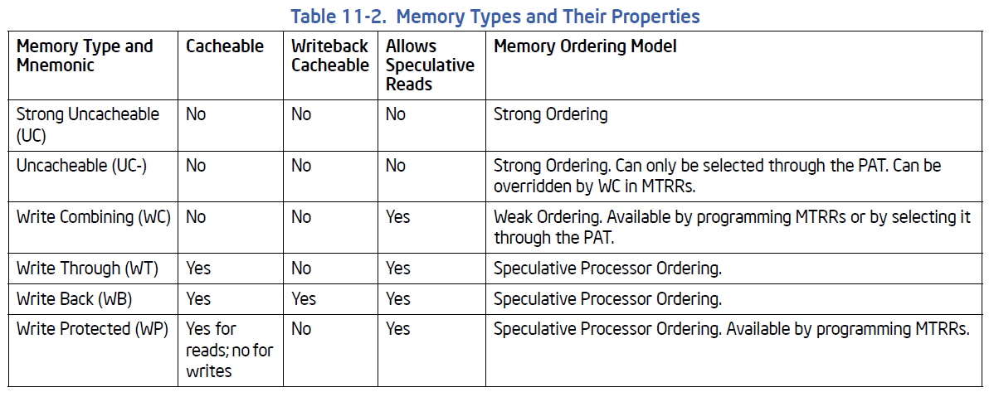
Memory Type Range Registers (MTRR)
MTRRs provide a mechanism for associating the memory types with physical-address ranges in system memory
Allows up to 96 memory ranges to be defined in physical memory

Slide 25
“Pre-memory”
Memory itself is a hardware resource and the memory controller itself must be set up
Prior to the set up (including testing), no DRAM is available
Thus far we are in read-only ROM BIOS and register land
In particular, no stack – hence no procedure call
To circumvent this, one way is to use the cache as memory
“No evict mode” – no eviction on miss
By setting the appropriate MTRR
Must “undo” after memory is available

Slide 26
“Post-memory”
With memory up and available, BIOS is ready to load in OS
Initialize secondary storage devices, scan boot sequence to find the master boot record (MBR) and verify its integrity
If all goes well, load the bootstrap loader – the code section of the MBR
For Intel, physical address 0x7C00
Does a jump to the bootstrap loader

Slide 27
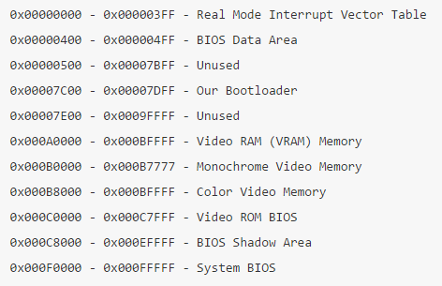
Intel Memory Map at Boot up

Slide 28
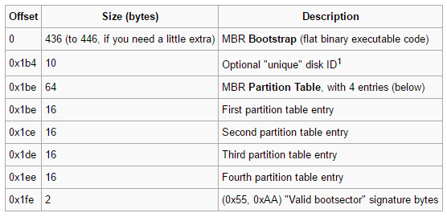
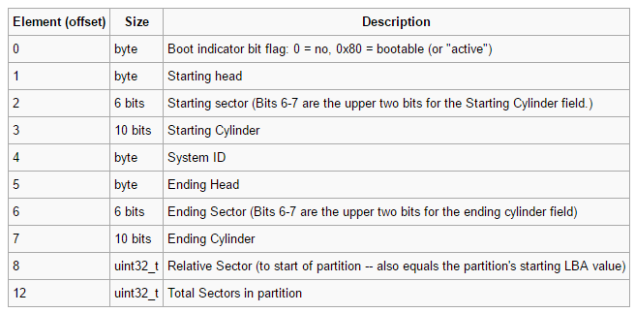
Master Boot Record
Master Boot Record
Partition Table Entry

Slide 29
Disk partitions
Disk partitioning is a way of organizing a physical disk.
A physical disk can contain multiple partitions, each a logical disk
Advantages:
Separate uses: OS, swap disk, user files
Some protection from misuse and corruption
“Short stroking”: reduce seek time as files are more localized
Disadvantages:
Increases fragmentation
Can restrict use

Slide 30
And in comes GRUB
For Linux, MBR is the first stage of GRUB, boot.img (GRUB stage 1)
See http://www.funtoo.org/Boot_image for annotated GRUB MBR
Up to now, everything is in real mode (or possibly unreal mode)
Boot.img locates and reads in diskboot.img and jumps to it (at location 0x2000)
Diskboot.img loads in the rest of GRUB (GRUB Stage 1.5)
Including drivers for handling (key) file systems
Control is transferred to grub_main() finally

Slide 31
The Linux/x86 Boot Protocol
https://www.kernel.org/doc/Documentation/x86/boot.txt
Dictates the memory layout, structures and initial values expected by the Linux kernel before and during the boot process

Slide 32
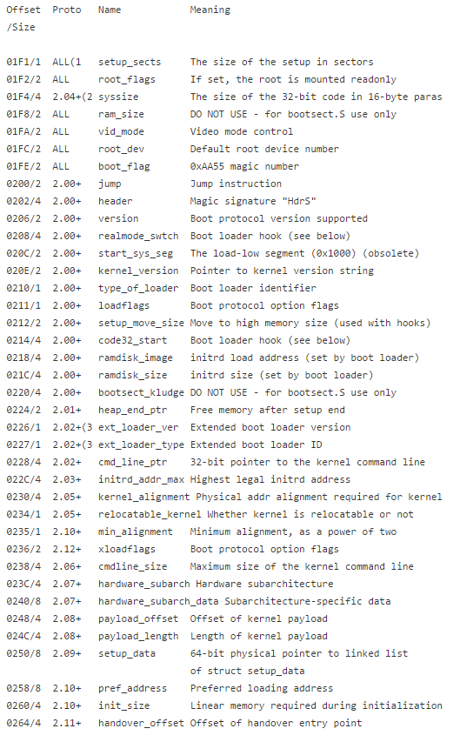
grub_main() – GRUB Stage 2
The Linux Kernel Header
Initializes the console
Gets the base address for modules
Sets the root device
Loads/parses the grub configuration file
Loads modules
Fill in the Linux kernel header
arch/x86/boot/header.S

Slide 33
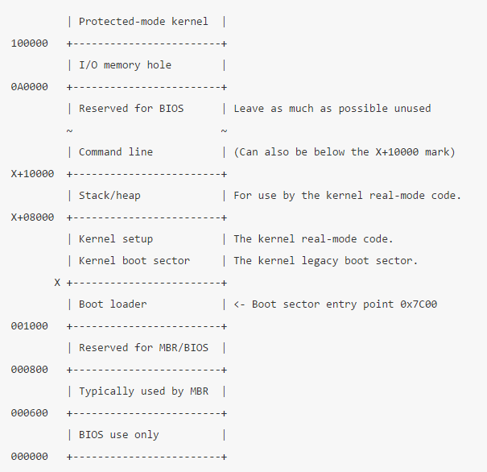
Memory map after kernel load
GRUB loads in both the kernel and RAMdisk. It will exceed the 1MB boundary. So it will transit to protected mode then load.

Slide 34
GRUB notation
hd stands for hard disk; alternatively, fd stands for floppy disk, cd stands for CD-ROM etc.
The first number refers to the physical hard drive number, starting from 0.
The second number refers to the partition number of the selected hard drive; again, starting from 0.

Slide 35
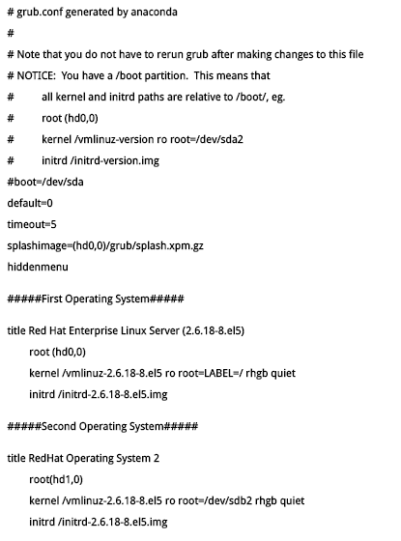
GRUB Configuration

Slide 36
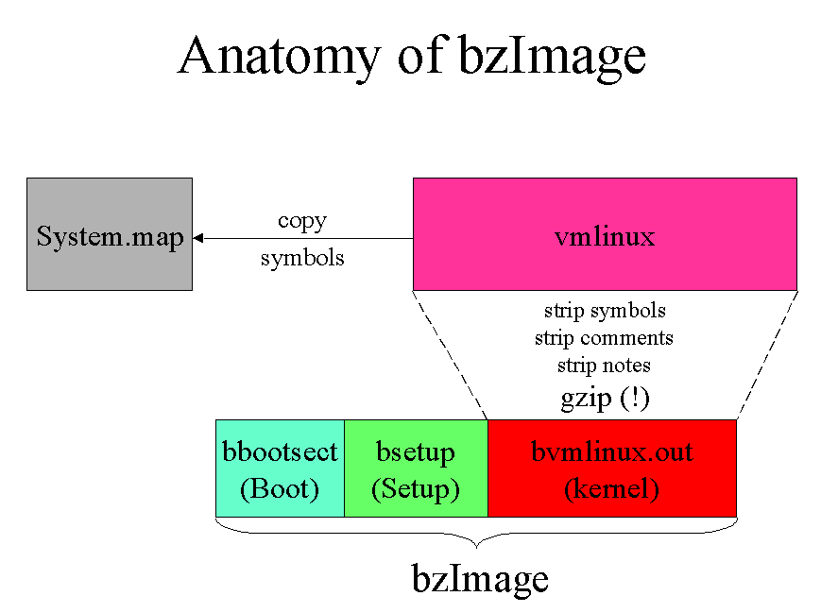
The Linux kernel
vmlinux - a statically linked executable file that contains the entire kernel
vmlinuz – compressed vmlinux
zImage – old kernel below 512KB that is loaded into low memory
bzImage – larger kernel loaded at above 1MB
(These days use vmlinuz directly.)

Slide 37
initrd
Zen koan: “Before you were born, what was your face?”
Before the OS gets booted, there is no drivers or file system, hence no files
But the boot process requires an environment to work in
Answer: a pre-laid out minimum file system that is so small that it can fit in RAM
Recall: BIOS brought DRAM on board, albeit in real mode

Slide 38
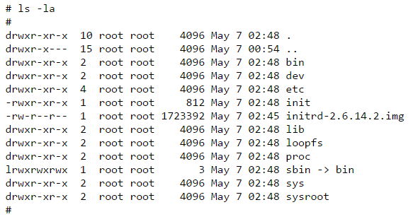
initrd
“Initial RAMdisk”: a temporary root file system in memory
Minimal set of directories and executables to support 2nd stage booting

Slide 39
initrd vs initramfs
Initrd:
A full file system image (may be compressed)
Driver for that file system (ext2, cramfs) must be compiled statically into the kernel
Can use pivot_root command to change it later
Initramfs:
A cpio file archive (like tar)
Unpacked into a file system of OS’s choice (usually tmpfs)
No need for special drivers compiled into kernel

Slide 40
Kernel boots
GRUB finally transfers control to _start in arch/x86/boot/header.S
Still in real mode!
Even though GRUB has loaded kernel and initrd into the higher addresses
More initializations
Make sure that all segment register values are equal
Set up a correct stack, if needed
Set up bss
Jump to the C code in main.c

Slide 41
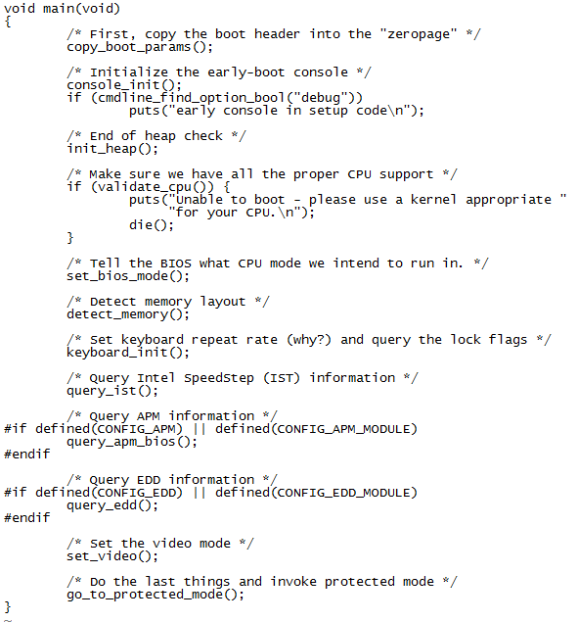
arch/x86/boot/main.c
Enters protected mode!

Slide 42
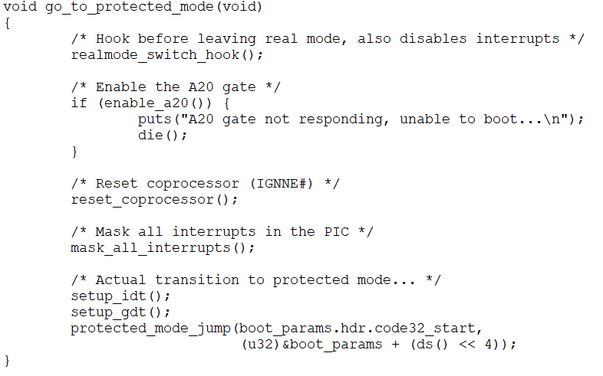
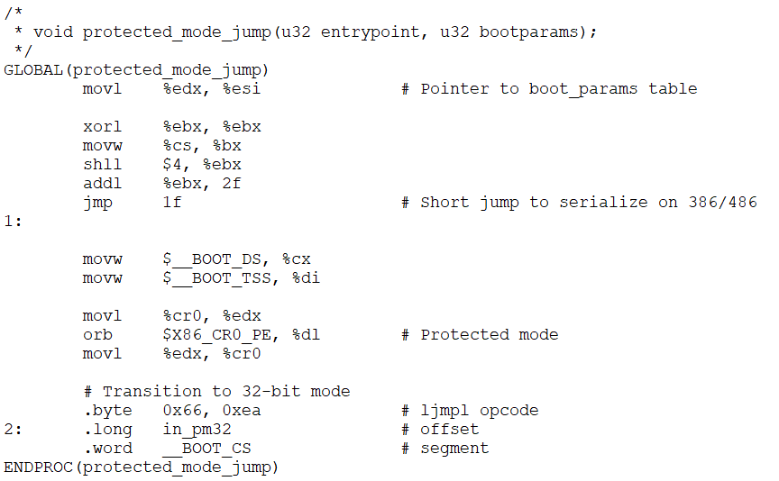
Switching to Protected Mode
arch/x86/boot/pmjump.S
arch/x86/boot/pm.c

Slide 43
Decompressing the kernel
Depending on whether the kernel is 32 bits or 64 bits, one of the following will be (eventually) called (in arch/x86/boot/compressed/head_{32|64}.S):
startup_32
startup_64
Build page tables
Linux uses 4-level paging
Decompress kernel via __decompress()

Slide 44
We are in!
After kernel decompression, control is transferred to startup_{32|64} of arch/x86/kernel/head_{32|64}.S
Note that this is a different routine from the ones that triggered decompression
More initialization
Eventually start_kernel() of init/main.c is called

Slide 45
initrd kicks in
Kernel mounts initrd as root, i.e., “/”
After initrd is mounted successfully, the function “run_init_process()” of init/main.c is called. This will execve the first user level process – init.
/sbin/init
/etc/init
/bin/init
/bin/sh

Slide 46
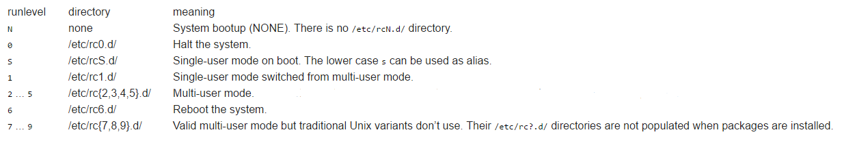
The init process
Distro dependent
Switches from initrd over to a disk root file system
Need to first load all the necessary drivers
init is the parent of all processes
Bulk of the boot messages originate from this point on
Culminates in the user selecting a bootlevel

Slide 47
systemd

Slide 48
systemd
Alternative to init
Starts processes in parallel
Supports interactive booting
Simpler API
x86 only (for now)
Still controversial

Slide 49
Features | init | systemd
Quota Management | No | Yes
Automatic Service Dependency Handling | No | Yes
Kills users Process at logout | No | Yes
Swap Management | No | Yes
SELinux integration | No | Yes
Support for Encrypted HDD | No | Yes
Static kernel module loading | No | Yes
GUI | No | Yes
List all the child processes | No | Yes
Interactive booting | No | Yes
Portable to non x86 | Yes | No
Adopted on | Several Distro | Several Distro
Parallel service startup | No | Yes
Resource limit per service | No | Yes
Easy extensible startup script | Yes | No
Separate Code and Configuration File | Yes | No
Automatic dependency calculation | No | Yes
Size | 560 KB | N/A
Number of Files | 75 files | 900 files + glib + DBus
Lines of code – LOC | ≈15,000 | ≈224,000
Source: https://www.tecmint.com/systemd-replaces-init-in-linux/

Slide 50
Configuration directories
/etc/systemd – Local configuration information
/run/systemd – Temporary files (testing, etc.)
/usr/lib/systemd – Vendors

Slide 51
Units
In systemd, everything is a unit
Units have
A Type
A State
May have a Status
A unit has a (usually unique) base‐name
Base‐name + Type = complete unit name

Slide 52
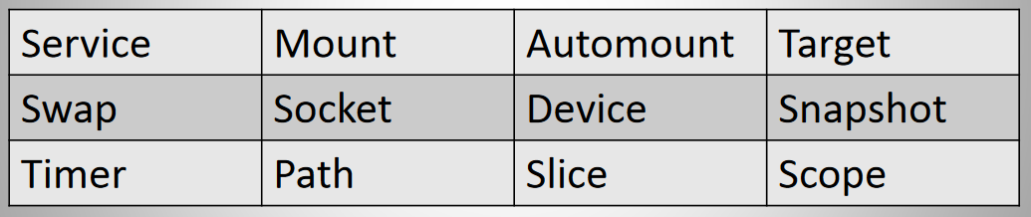
Unit types

Slide 53
Dependencies and Ordering
In systemd, dependencies and ordering determines when to start and stop units
Dependencies:
“Wants” (soft)
“Requires” (hard)
Ordering:
“After”
“Before”

Slide 54
The Daemons
systemd ‐ The main systemd process. This is the replacement for “/etc/init”.
journald ‐ Event logging.
networkd ‐ Manages network configuration.
logind ‐ Manages user logins.
udevd ‐ Manages devices.

Slide 55
Initialization
When running as “init” (PID = 1), the following configuration files are read and acted on accordingly:
/etc/systemd/system.conf
/etc/systemd/system.conf.d/*.conf
/run/systemd/system.conf.d/*.conf
/usr/lib/systemd/system.conf.d/*.conf

Slide 56
Initialization
When running as a user processor (PID ≠ 1), the following configuration files are used:
/etc/systemd/user.conf
/etc/systemd/user.conf.d/*.conf
/run/systemd/user.conf.d/*.conf
/usr/lib/systemd/user.conf.d/*.conf

Slide 57
Unit files
Each unit has a file in one or more of the following directories:
/etc/systemd/system
/usr/lib/systemd/system
Some units have “drop in” files in:
/etc/systemd/system/<unit>.d/*.conf
/run/systemd/system/<unit>.d/*.conf
/usr/lib/systemd/system/<unit>.d/*.conf
See: man systemd.unit

Slide 58
Using systemd
Management tools (see their man pages):
systemctl
journalctl
systemd-cgls
See: https://www.tecmint.com/systemd-replaces-init-in-linux/
See: http://0pointer.de/blog/projects/systemd-for-admins-1.html

Slide 59
UEFI

Slide 60
Successors to BIOS
OpenBIOS: https://openbios.info/Welcome_to_OpenBIOS
Libreboot: https://libreboot.org/
Open Firmware: https://github.com/openbios
Coreboot: https://www.coreboot.org/Welcome_to_coreboot
The main stream one: UEFI

Slide 61
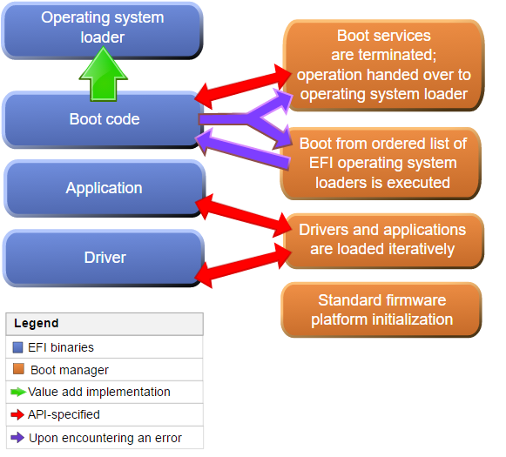
Unified Extensible Firmware Interface (UEFI)
Successor of traditional BIOS
Legacy support usually provided in implementations
Able to boot from large disks (over 2TB)
CPU independence
Modular
Uses GUID Partition Tables

Slide 62
LBA vs CHS
Traditionally, disks are addressed using cylinder/head/sector (CHS) tuples
Dependent on the physical device
Logical Block Addressing (LBA) introduced in the SCSI standard as an abstraction
Current standard is to use 48-bit LBA
Access to up to 128 PiB (pebibyte = 1024⁵ bytes)

Slide 63
LBA ↔ CHS
LBA = (C × HPC + H) × SPT + (S - 1)
C, H and S are the cylinder number, the head number, and the sector number
LBA is the logical block address
HPC is the maximum number of heads per cylinder (reported by disk drive)
SPT is the maximum number of sectors per track (reported by disk drive)
C = LBA ÷ (HPC × SPT)
H = (LBA ÷ SPT) mod HPC
S = (LBA mod SPT) + 1

Slide 64
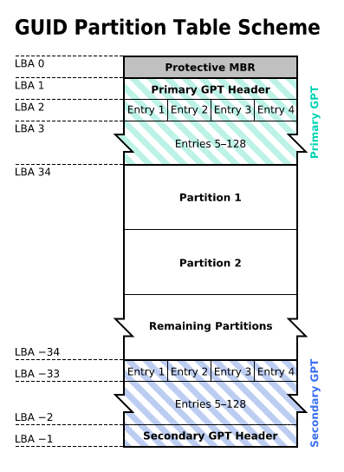
GUID Partition Table (GPT) format
A new partition structure for UEFI
Traditional MBR uses 32 bits to store LBA and worse, partitions of up to 2 TiB size
Now supported by all OSes
For backward compatibility, LBA 0 is basically the same as MBR
Protective MBR – can only boot via EFI
Hybrid MBR – contains modified bootloader that knows how to handle GPT in BIOS

Slide 65
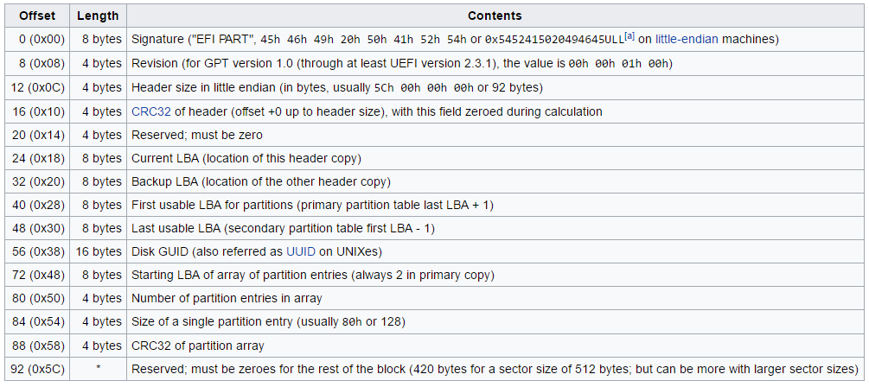
Primary GPT Header

Slide 66
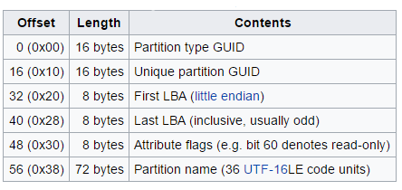
GUID Partition Entry Format

Slide 67
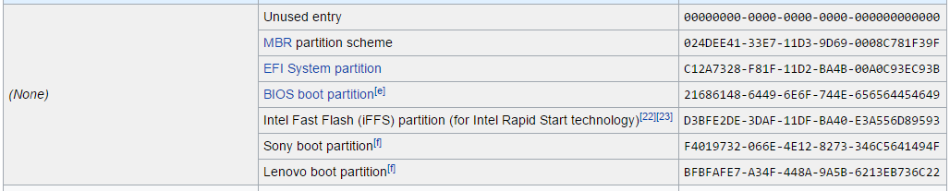
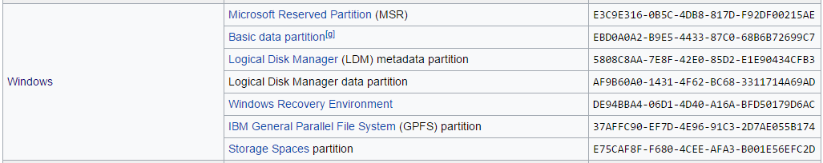
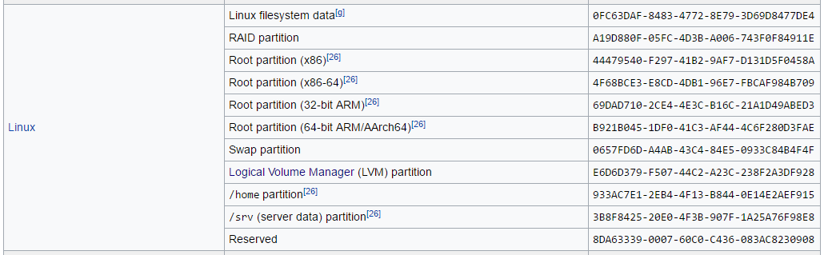
Global Unique Identifier (GUID)
Partition Type GUID

Slide 68
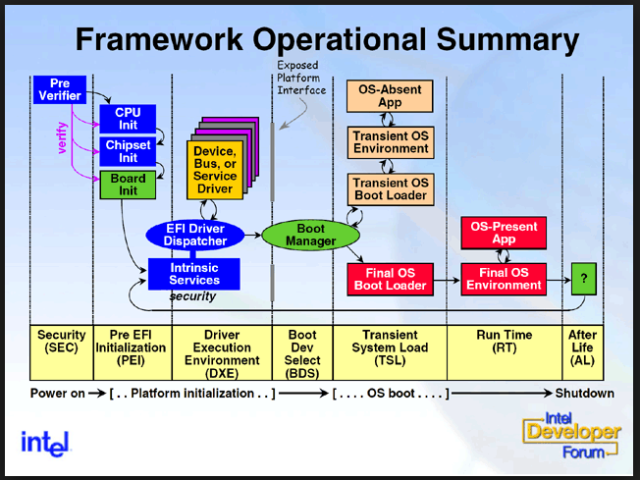
UEFI Boot Process

Slide 69
UEFI Boot Process
SEC
Target of reset vector
Verify integrity of the PEI code
Set up Cache-as-RAM
Runs the PEI
PEI
Initializes hardware
Loads and execute DXE

Slide 70
DXE (Driver Execution Environment)
Almost a mini-OS (complex)
When it is up, there is a file system with various bootloader executables
Goal: setup all the necessary drivers so that the actual OS’s bootloader has most of what it needs to work with
Architectural abstraction
Finds the EFI_SYSTEM_PARTITION, sets up and mount FAT32 file system
Depending on user preferences, execute the boot loader
For Linux, usually GRUB 2

Slide 71
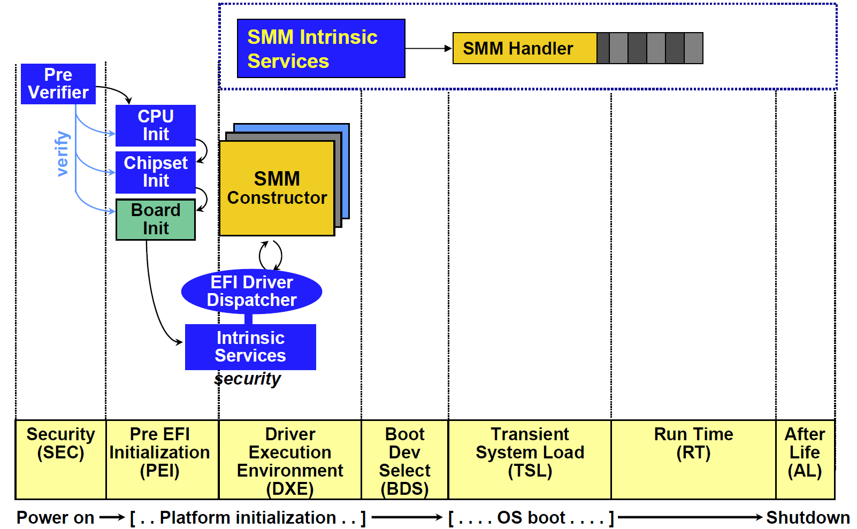
UEFI and SMM

Slide 72
BIOS vs UEFI boot
UEFI does not run the MBR bootstrap loader
No 446 byte limit
UEFI loads a FAT32 file system driver and sets up a FAT32 root file system

Slide 73
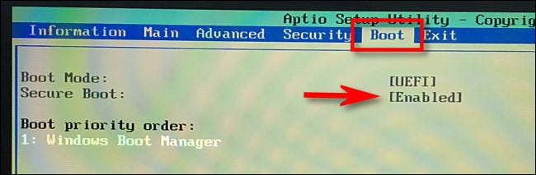
UEFI Secure Boot
The danger: the BIOS will boot any software including malware
Bootkits: kernel mode rootkits (malicious software) that infect startup code
Solution: make sure only boot with certified boot code
Use standard digital signatures of cryptographic keys

Slide 74
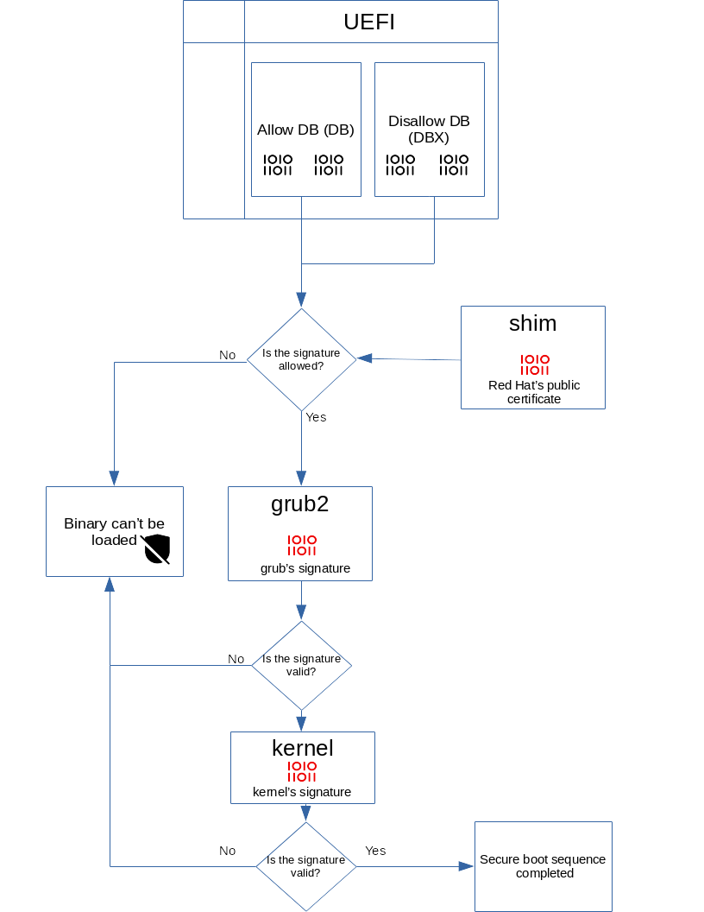
Basic idea
UEFI comes with a set of keys burnt into ROM
Use keys to authenticate software to be loaded
Using public key cryptography
Initially, only for Windows (coz UEFI founded by Microsoft and Intel)
Linux later let in by via “shim”
Windows 11 will require both secure boot as well as TPM 2.0 (Trusted Platform Module – a hardware security chip)

Slide 75
End

